Slide 1
Patient Satisfaction
Team Data Doctor

Slide 2
Problem
Patients Satisfaction
Hospital:
Hospital Care Expenses/Costs: $500,000 to $850,000 annually per hospital at risk
Medicare reimbursement

Slide 3
Goal and Solutions
Patient Satisfaction
Drive Recommendation rate
Maximum Revenues and Reduce Costs

Slide 4
Values
Improve Patient Satisfaction
Revenue Streams: Greater inpatient use, higher overall health care, and prescription drug expenditures
Additional $2.2 million to $5.4 million annual revenue

Slide 5
Healtrics

Slide 6
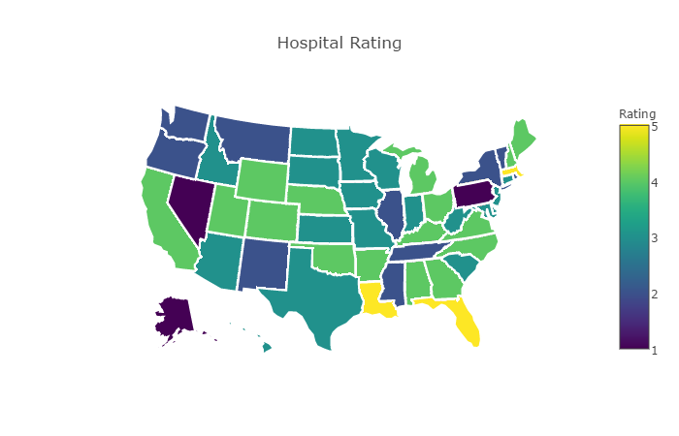
Targeted Market and Customers

Slide 7
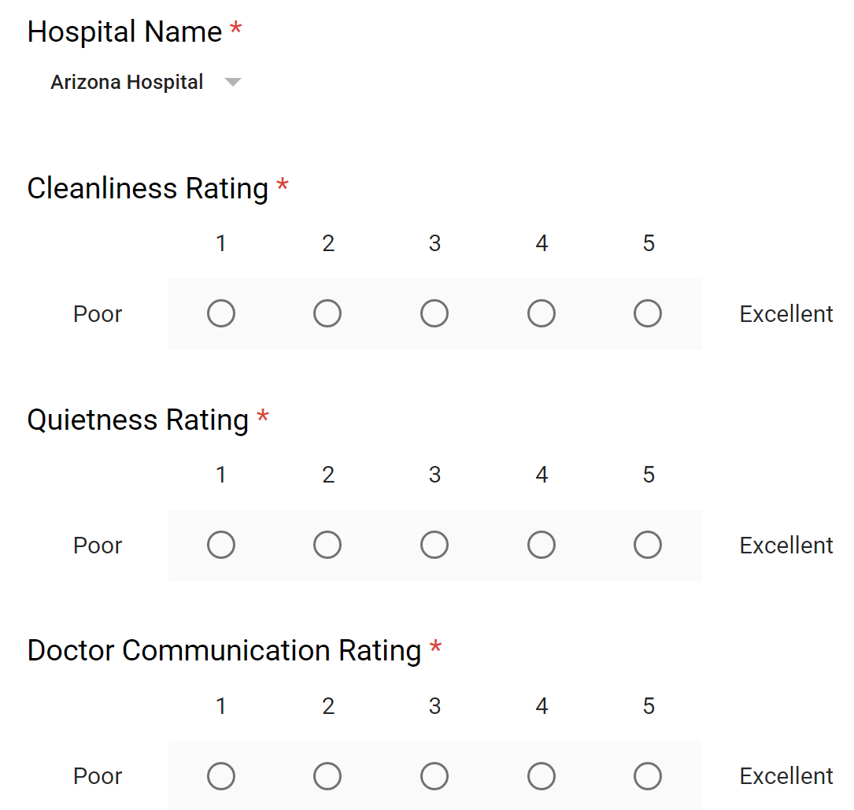
Product
How It Works
Hospital Consumer Assessment of Healthcare Providers and Systems (HCAHPS) survey

Slide 8
Competitive Advantages
Accuracy
Real-time
Generalizable
Scalable

Slide 9
Growth Trends In This Business

Slide 10
Final point
Visualization of three data tables

Slide 11
Thank You! Q & A

